Slide 1


GTP Vulnerabilities in 5G
BAndrei

Slide 2


Content
What is GTP
How is GTP related to 5G
Vulnerabilities
Prevention
Conclusion

Slide 3
What is GTP
2.5G
Interconnects different networks
Used mainly in EPC Roaming
Has a User Plane and Control Plane (GTP-U and GTP-C)
Not security oriented design
GTP = GPRS Tunneling Protocol
GPRS = General Packet Radio Service
EPC = Evolved Packet Core

Slide 4
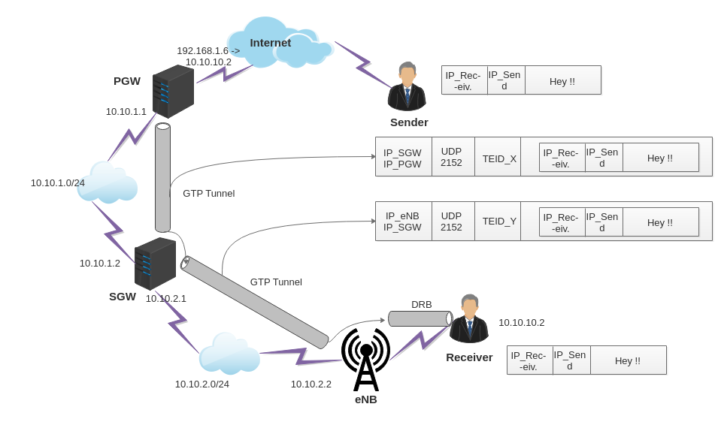
Packet Data Network Gateway
Serving Gateway
Data Radio Bearer
Evolved Node B

Slide 5
How is GTP related to 5G
GTP is still used for user plane traffic in 5G
Some 5G networks are deployed on EPC
Few security measures put in place by operators

Slide 6
Vulnerabilities
No encryption, integrity protection or sender authentication
Attacks:
Eavesdropping
Denial of Service
Fraud
Rogue Base Stations
Malicious Peers
Roaming IoT

Slide 7
Prevention
Firewalls
message filtering
exploit detection
message-length control
validity checking
plausibility checking

Slide 8
Conclusion
Unsecure initial design based on security through obscurity
Kerckhoff's principle
Using counter measures is necessary

Slide 9
References
https://www.a10networks.com/blog/gtp-remains-a-5g-security-threat-as-operators-transition-to-5g/
https://www.a10networks.com/wp-content/uwwwploads/A10-SB-19202-EN.pdf
https://medium.com/@sakunaj1996/gtp-gprs-tunneling-protocol-25edc51dc76e
https://techmonitor.ai/techonology/cybersecurity/gtp-protocol

